Slide 1

Swami Keshvanand Institute of Technology,
Management & Gramothan, Jaipur
Department of Information Technology
A Presentation
on
INFOTRIX
by
Ram modi
21ESKIT093
For the completion of
Industrial Training Seminar
2022-23
IoT CoE| IBM Academic Initiative | Infosys Campus Connect | Natural Group

Slide 2
Swami Keshvanand Institute of Technology,
Management & Gramothan, Jaipur
Department of Information Technology
Content:
Abstract
Introduction
Key Features
Feedback is important
Existing Projects/Websites
Tools and Technology Used
Project Screenshots
Springer CCIS | IBM Academic Initiative | Infosys Campus Connect | Natural Group

Slide 3
Swami Keshvanand Institute of Technology,
Management & Gramothan, Jaipur
Department of Information Technology
Abstract of the project
Infotrix basically deals with the area of latest news or knowledge . As the name suggest Infotrix is just similar to an information of matrix of news. Where we have included the topic search by mostly on Google.
In this project the user will be able to look on trend change with on the go collecting useful information.
Springer CCIS | IBM Academic Initiative | Infosys Campus Connect | Natural Group

Slide 4
Swami Keshvanand Institute of Technology,
Management & Gramothan, Jaipur
Department of Information Technology
Introduction
Infotrix is related or similar to a news site.
Infotrix cover the following fields:
1) Sports
2) Technology
3) Politics
4) Business
5) Devotion(information)
6) Master(music info)
7) Genius(scientist info)
Springer CCIS | IBM Academic Initiative | Infosys Campus Connect | Natural Group

Slide 5
Swami Keshvanand Institute of Technology,
Management & Gramothan, Jaipur
Department of Information Technology
Key Features
Easy to use
Attractive
One for all
Wide range of topics
User friendly
Responsiveness
Springer CCIS | IBM Academic Initiative | Infosys Campus Connect | Natural Group

Slide 6
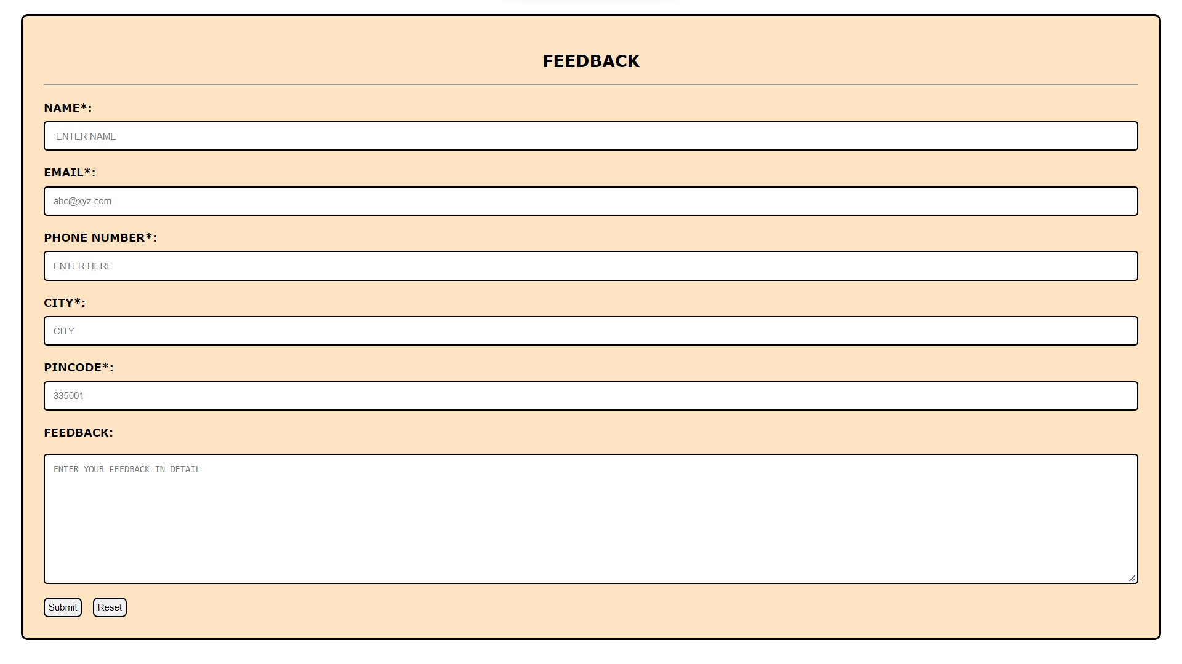
Swami Keshvanand Institute of Technology,
Management & Gramothan, Jaipur
Department of Information Technology
Feedback is Important
Feedback is a very important part of any product as it plays a major role to upgrade it according to the user demand.
Springer CCIS | IBM Academic Initiative | Infosys Campus Connect | Natural Group

Slide 7
Swami Keshvanand Institute of Technology,
Management & Gramothan, Jaipur
Department of Information Technology
Existing Projects/Websites
There are many websites deals with the same concept like THE HINDU, NBC NEWS, THE ECONOMIC TIMES and many more.
INFOTRIX give advantage above all of them by providing a common platform for all the topic of interest including technology, sports, stock market and all.
Springer CCIS | IBM Academic Initiative | Infosys Campus Connect | Natural Group

Slide 8
Swami Keshvanand Institute of Technology,
Management & Gramothan, Jaipur
Department of Information Technology
Tools and Technology used
For the development of this website many different platform and programming languages used
Programming languages and Technology used:
HTML
CSS
JAVASCRIPT
PHP
Software used:
XAMPP
VISUAL STUDIO CODE
Google drive(image source)
Springer CCIS | IBM Academic Initiative | Infosys Campus Connect | Natural Group

Slide 9
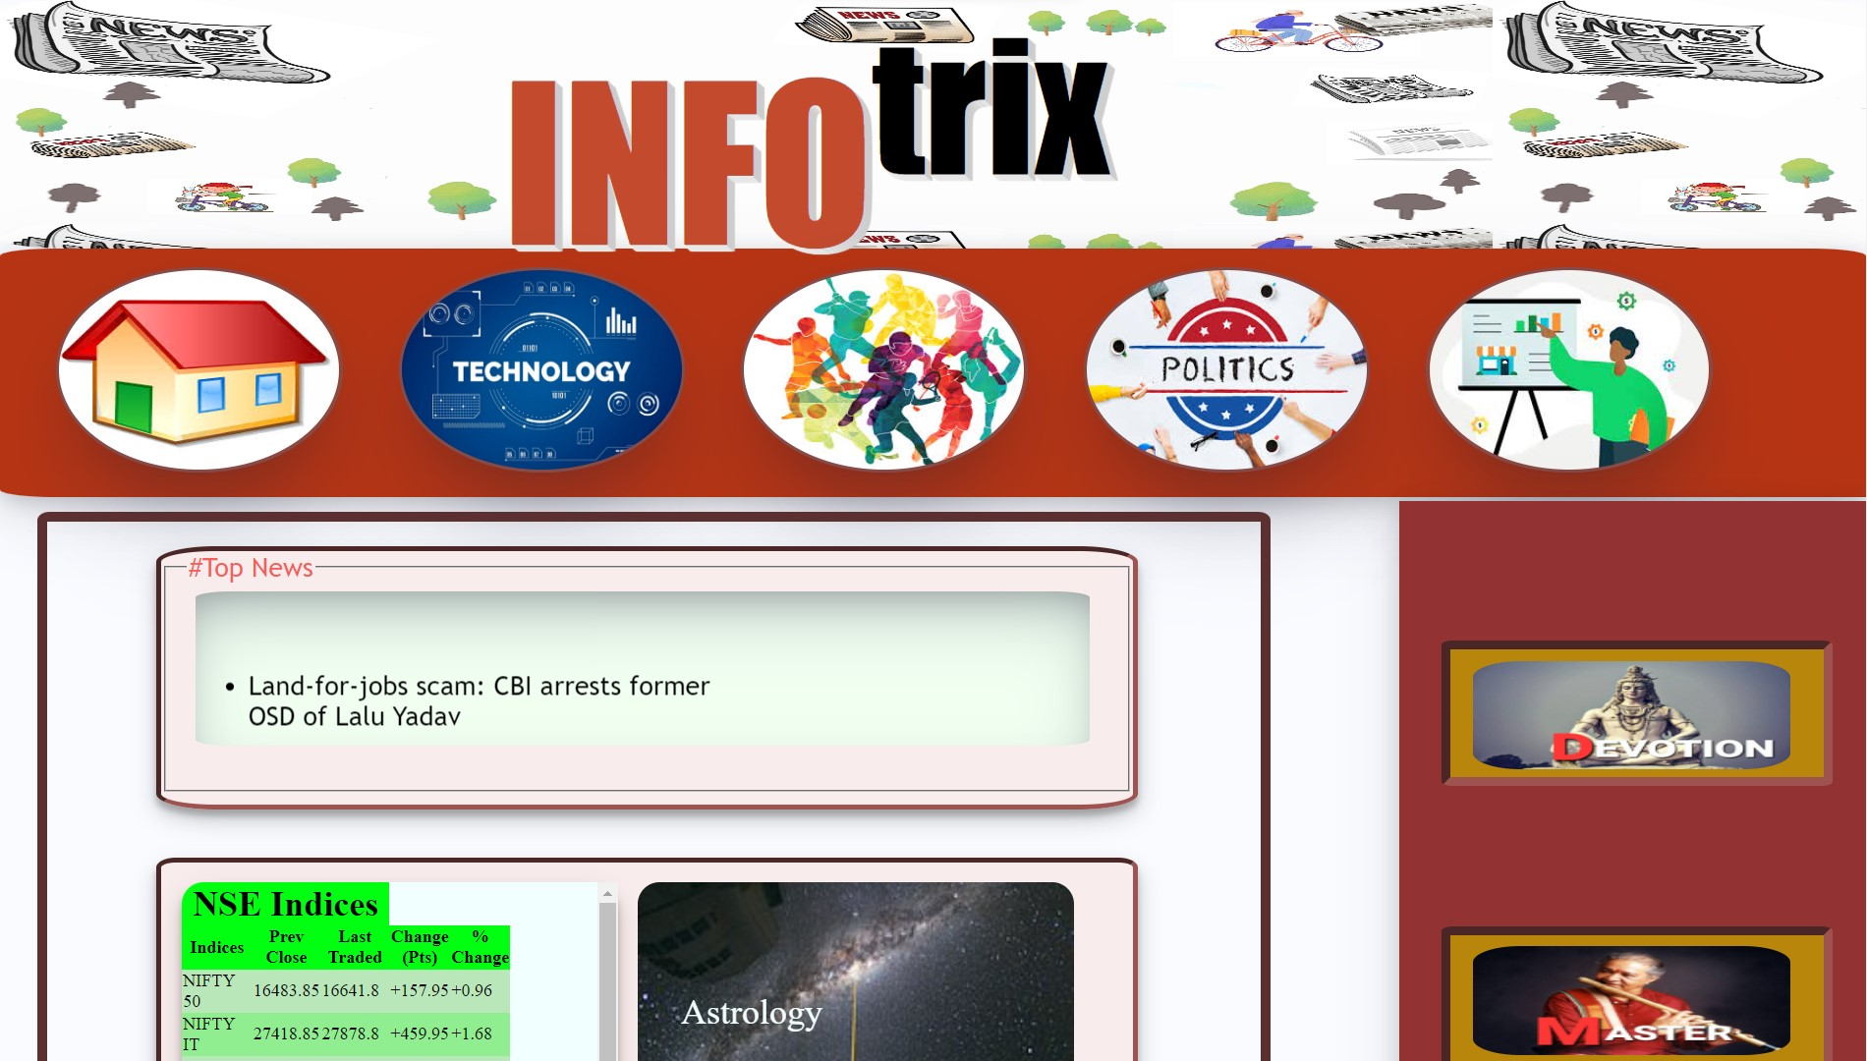
Swami Keshvanand Institute of Technology,
Management & Gramothan, Jaipur
Department of Information Technology
Project Screenshots
Springer CCIS | IBM Academic Initiative | Infosys Campus Connect | Natural Group

Slide 10
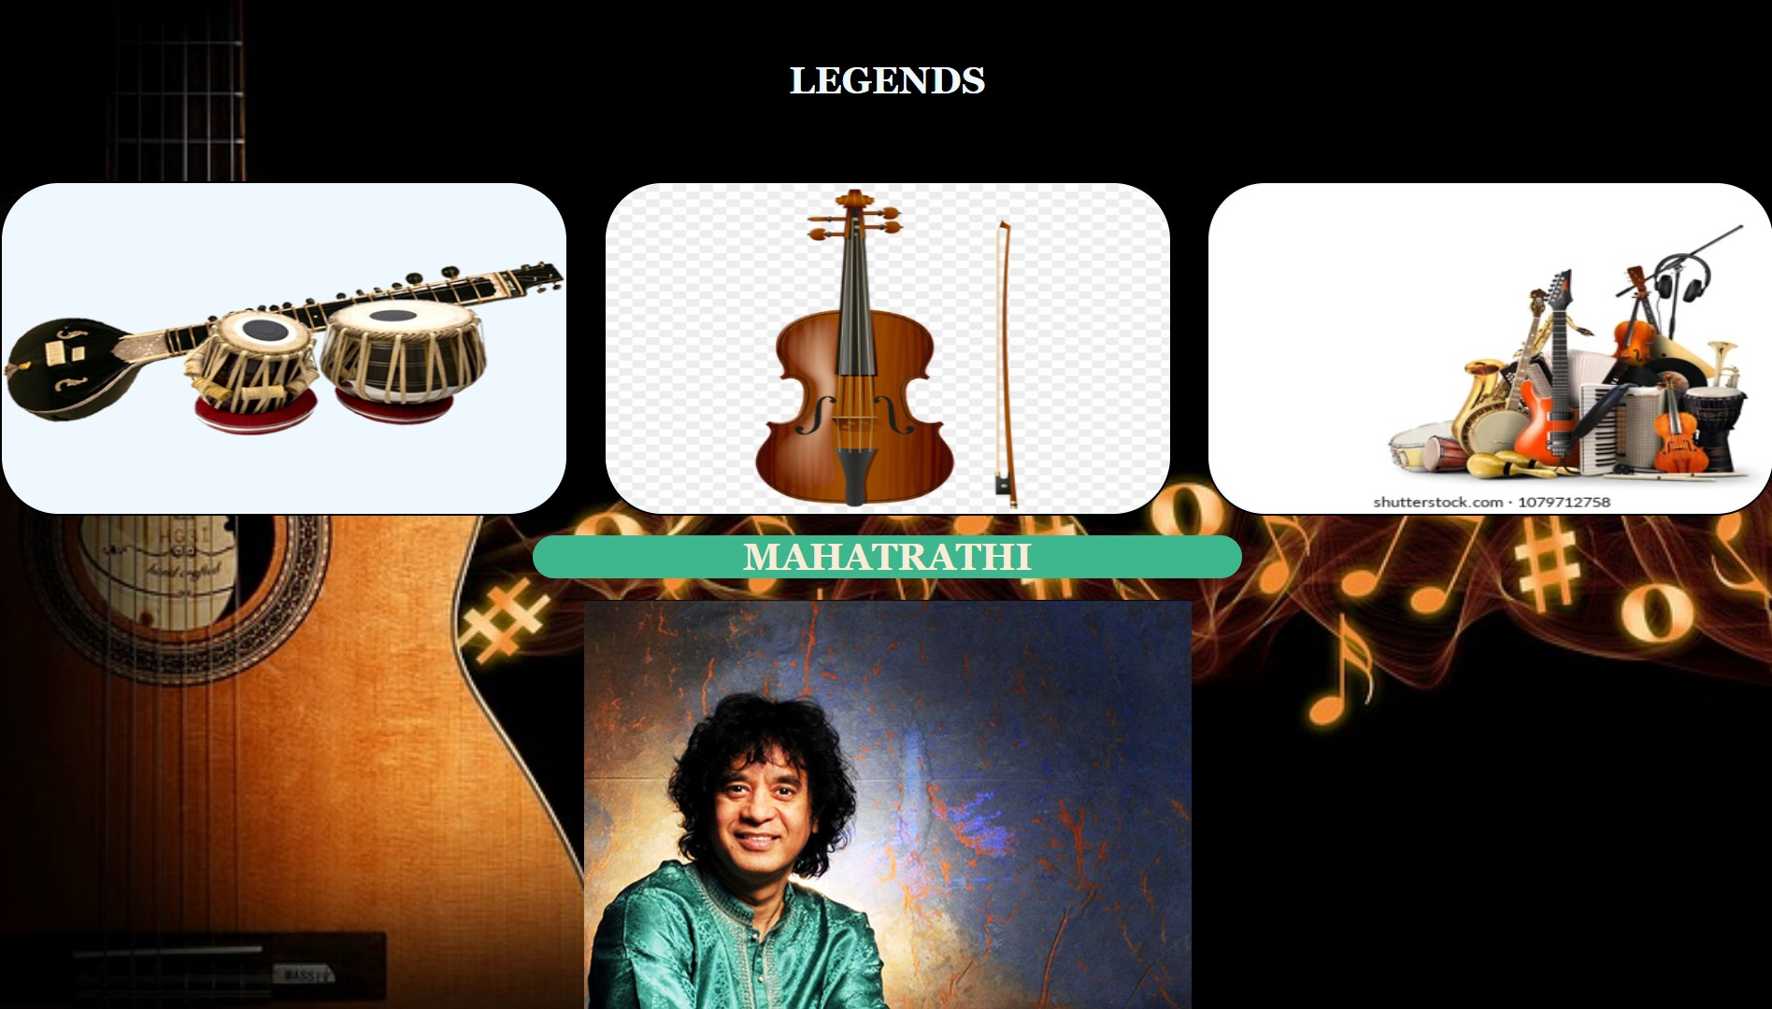
Swami Keshvanand Institute of Technology,
Management & Gramothan, Jaipur
Department of Information Technology
My Role
Springer CCIS | IBM Academic Initiative | Infosys Campus Connect | Natural Group

Slide 11
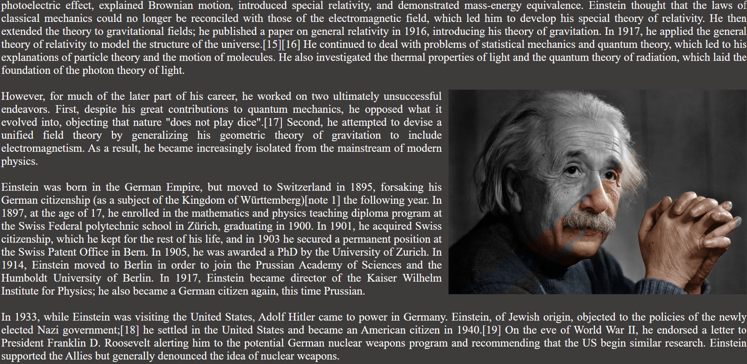
Swami Keshvanand Institute of Technology,
Management & Gramothan, Jaipur
Department of Information Technology
My role
Springer CCIS | IBM Academic Initiative | Infosys Campus Connect | Natural Group

Slide 12
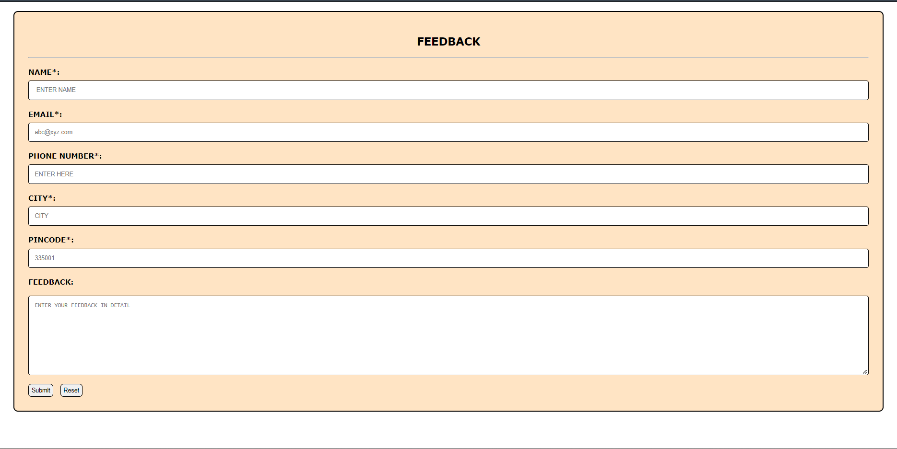
Swami Keshvanand Institute of Technology,
Management & Gramothan, Jaipur
Department of Information Technology
My role
Springer CCIS | IBM Academic Initiative | Infosys Campus Connect | Natural Group

Slide 13

Swami Keshvanand Institute of Technology,
Management & Gramothan, Jaipur
Department of Information Technology
My role
Springer CCIS | IBM Academic Initiative | Infosys Campus Connect | Natural Group

Slide 14
Swami Keshvanand Institute of Technology,
Management & Gramothan, Jaipur
Department of Information Technology
THANK YOU
Springer CCIS | IBM Academic Initiative | Infosys Campus Connect | Natural Group

